Slide 1
Phonetics: The Sounds of English Language

Slide 2
Topics to be covered
Definition of Phonetics
Speech Sound
Phonetic Alphabet
Understanding Syllables
Degrees of stress
Notation
Resources for further study:
https://www.youtube.com/watch?v=vzsQkjX4fD8

Slide 3
Speech Sound
Phonetics is the study of speech sounds
Knowing a language includes knowing the sounds of that language
English is not a phonographic language, i.e. spellings generally do not give a clear indication of pronunciation
Same spelling for different sounds
Combination of letters representing one sound,
Some letters are silent
Necessary for Indian students to make a systematic study of the English sound system.

Slide 4
Sounds
Vowels
Air comes out freely through the mouth
No closure of the air passage
No narrowing of the passage that would cause audible friction.
Consonants
the closure or narrowing takes place

Slide 5
Do the highlighted letters in each of the following sets of words represent the ‘same’ sound?
a) city, cotton, species, cello.
b) gold, ginger, gnaw, high
c) can, can't, ancient, sofa.
d) bus, news, vision, Asia.
e) sit, site, machine, racial.
f) stuff, rough, cough, through.
g) kick, charisma, unique, cut.
h) may, lame, fail, hey.
i) chef, shell, mission, special

Slide 6
Let’s pronounce these words:
Wednesday
Execute
Executive
Relative
Exchequer
Genre
Wind chimes
Liaison
Sesame
Strategy
Strategic
Economics
Economy
Project
Trio
Hazard
Exorbitant
Suit
Suite
Hotel
Vehicle
Academy
Academic
Academician
Helped
Competitive

Slide 7
Phonetic Alphabet
One symbol represents one sound
Each speech sound has a distinct symbol
Cross-linguistically applicable

Slide 8
International Phonetic Alphabet (IPA)
Unique alphabet/symbol for each sound
Always written in small case
Always put between slashes eg. /put/
Colon (:) in vowel sounds represent stress (long sound)

Slide 9
IPA Symbols for Transcription (12 Vowel Sounds)
/i/ as in ship
/i:/ as in sheep
/ ɛ / as in bed
/æ/ as in bad
/ʊ/ as in put
/u:/ as in boot
/ɔ/ as in hot
/ɔ:/ as in caught
/ə/ as in about
/ə:/ as in serve
/ʌ/ as in but
/ɑ:/ as in father

Slide 10
IPA Symbols for Transcription (24 Consonant Sounds)
/p/ as in pat
/b/ as in bat
/t/ as in tap
/d/ as in dam
/k/ as in car
/g/ as in guard
/f/ as in foot
/v/ as in van
/h/ as in hat
/m/as in mull
/n/ as in null
/s/ as in sap

Slide 11
IPA Symbols for Transcription (24 Consonant Sounds Contd.)
/r/ as in ring
/l/ as in leaf
/w/ as in with
/z/ as in zip
/ŋ/ as in ring
/θ/ as in think
/ð/ as in this
/ʃ/ as in shine
/ʒ/ as in vision
/ʧ/ as in touch
/ʤ/as in judge
/j/ as in yes

Slide 12
Diphthongs (8 Complex Vowel Sounds)
Complex because they are two-part vowels
But count as a single sound because two vowels are articulated together
/eɪ/ as in bait
/ɑɪ/ as in bite
/ɔɪ/ as in boil
/əu/ as in home
/au/ as in house
/iə/ as in cheer
/ ɛə/ as in air
/uə/ as in poor
Notes:
Bite
Brown
Boy

Slide 13
The phonetic alphabet
A combination of letters may represent single sound
Shoot character Thomas
Either physics rough
Coat deal
A single letter may represent a combination of sounds
XEROX

Slide 14
Some letters in a word are not pronounced at all
Autumn
Sword
Resign
Lamb
Psychology
Write
knot

Slide 15
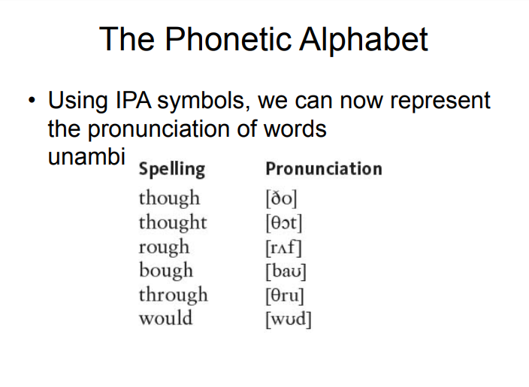

Slide 16
Understanding Syllables
To understand word stress, it helps if we understand syllables.
Every word is made of syllables.
Each word has one, two, three or more syllables.
Word |  | Number of syllables
Hot | Hot | 1
Water | Wa.ter | 2
Inferno | In.fer.no | 3
Interesting | In.ter.est.ing | 4
Unexceptional | Un.ex.cep.tion.al | 5

Slide 17
DEGREES OF STRESS
Primary stress
It is the stronger degree of stress.
Primary stress gives the final stressed syllable.
Primary stress is very important in compound words.
Secondary Stress
It is the weaker of two degrees of stress in the pronunciation of a word.
Secondary stress gives the other lexically stressed syllables in a word.
Secondary stress is important primarily in long words with several syllables

Slide 18
NOTATION
Different systems exist for indicating syllabification and stress.
In IPA, primary stress is indicated by a high vertical line before the syllable, secondary stress by a low vertical line. Example: /sɪˌlæbəfɪˈkeɪʃən/
In English dictionaries which do not use IPA, stress is typically marked with a prime mark placed after the stressed syllable: /si-lab′-ə-fi-key′-shən/

Slide 19
Here’s an example…
The mice will go to the moon tomorrow to take over the world.
Who?
The mice will go to the moon tomorrow to take over the world.
Where?
The mice will go to the moon tomorrow to take over the world.
When?
The mice will go to the moon tomorrow to take over the world.
To do what?
The mice will go to the moon tomorrow to take over the world!

Slide 20
Watch the video
https://www.youtube.com/watch?v=dfoRdKuPF9I

Slide 21
MCQ
Which of these terms refer to the study of speech process? a) Phonology b) Phonetic substances c) phonetics d) Semantics
2. What is the full form of IPA? a) Indian Phonetic Alphabet b) International Phonetic Alphabet) International Phonetic Agreementd) Indian Phonetic Agreement
3. What does the sign / / represent?
Phonetic transcription b) Centralization c) Voiced bilabial nasal d) Rising- falling pitch
4. Which one of the following is not an organ of speech? A. leg B. Tongue C. Vocal chord D. Lips
5. . 5. Total Number of consonant sound in English is A. 12 B. 8 C. 20 D. 24

Slide 22
Learning outcome
Apply the acquired skills in delivering effective presentations
Apply Phonetics through theory and practice for better pronunciation

Slide 23
Relevance
To make our diction and pronunciation more refined
To understand the science of language in greeter depth

Slide 24
References
https://www.academia.edu/39268853/Phonetics_The_Sounds_of_Language_Introduction_to_Linguistic_Theory
R.K Bansal, and J.B Harrison, Spoken English for India, Orient Longman, 2018

